Slide 1
An Integrated Experimental Environment for Distributed Systems and Networks
Esha Desai
USC ID: 6993245898

Slide 2
Introduction to Netbed
An experimentation facility integrating network emulators, network simulators, and live networks.
Is a time and space shared platform where virtual topology translated to physical nodes from a cluster
Integrates emulation, simulation and wide area nodes
It runs arbitrary workload i.e. any OS image, any code on “routers" or any program, for any user
Ns scripts/GUI for specifying virtual topology
Netbed virtual machine :
Abstraction
Conservative resource allocation, scheduling and preemption
Hard/soft state management

Slide 3
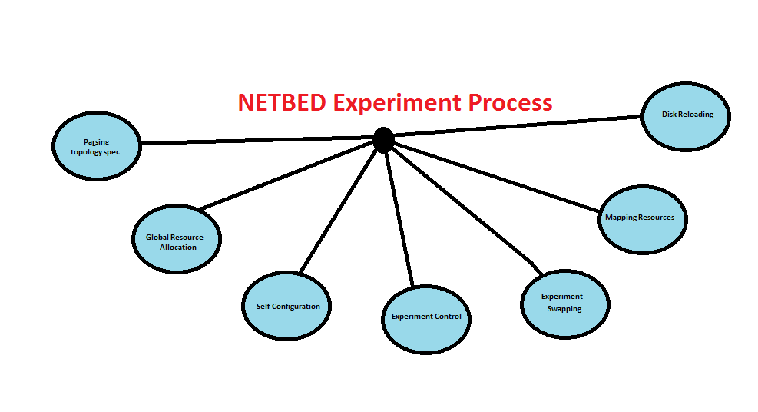
Netbed Experiments

Slide 4
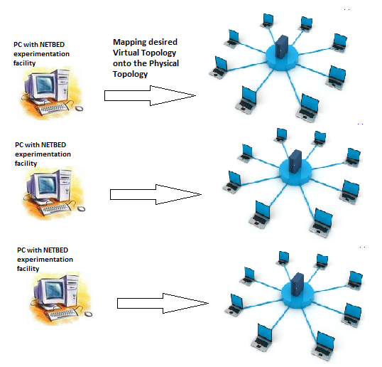

Slide 5
Question
Need for Netbed or any Integrated Environment. Why???
Live networks give real results but they cannot be scaled and do not have repeatability
Pure emulation difficult to configure
The configuration time can exceed actual experiment time
Simulation techniques give high amount of abstraction and hence incur loss of low level details
Netbed speeds up emulation and configuration time by virtual topology and events specified by the ns script/Java GUI
It achieves scalability and resource sharing by sharing a physical experiment cluster amongst experimenters on a demand basis
It provides a “virtual machine” for network experimentation by OS-like tasks [ like resource allocation, scheduling, preemption], single namespace, hard/soft state management, abstraction etc

